Slide 1

Probation 101
Developed By:
Devin Petersen with
Pine County Probation

Slide 2
Interested in Becoming an Agent?
Attributes of Successful Agents
Maybe Reconsider If
Relationship Building
Communication Skills
Writing Skills
Critical Thinking Skills
Organizational Skills
Emotional Stability
Power Trips
Time Management
Setting Boundaries
Recognizing Bias
Technology
Organization

Slide 3
What do YOU know about community supervision?
How & when did probation begin?
John Augustus
2:20 – 5:00
What is the purpose of COMMUNITY SUPERVISION?
“An alternative to incarceration aimed at REHABILITATION”

Slide 4
Probation is . . .
Minnesota Statute 609.02
  A court-ordered sanction involving community supervision
  Alternative to confinement
  Purpose of probation:
    Deter further criminal behavior
    Provide reparation for crime victims/communities
    Provide individuals an opportunity for rehabilitation
    Punishment

Slide 5

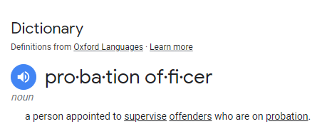
What IS a
Probation Agent?

Slide 6
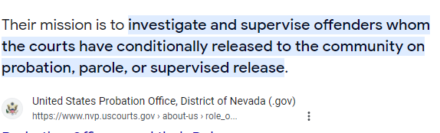
What IS a
Probation Agent?

Slide 7
Juvenile Agent
Adult Agent
Probation
is
“Bridging the Gap” between
Social Work
&
Law Enforcement

Slide 8
Collaboration
Law Enforcement
Teachers
ARMHS Workers
Veterans Services
Psychologists
Social Workers
Case Managers
Therapists/Counselors
Licensed Alcohol & Drug Counselors
Family/Friends of Clients
School Administrators
Non-Profit Organizations
Jails
Prisons
Detention Centers
Outpatient/Inpatient Treatment Programs
Attorneys
Court Administration
Judges
Psychiatrists

Slide 9
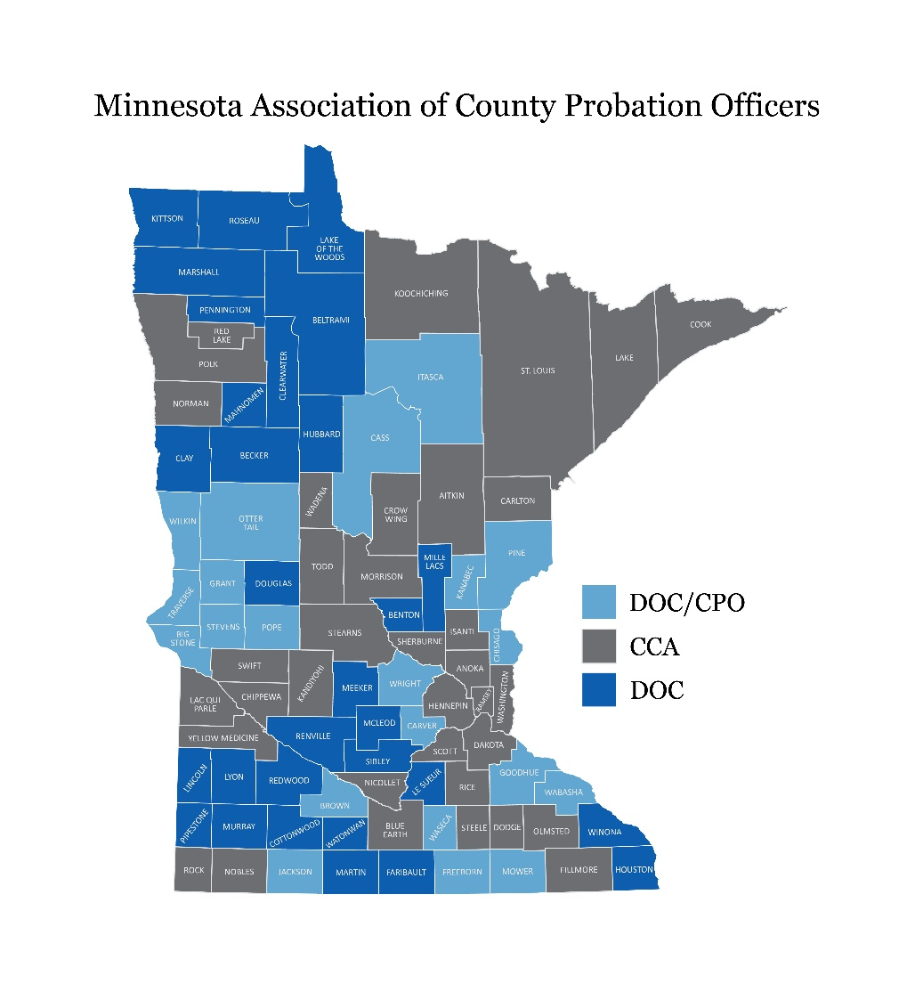
Community Supervision in
Minnesota

Slide 10
Community Supervision
broad term REFERRING TO ALL INDIVIDUALS on SUPERVISION:
  Diversion
  Pretrial Conditional Release Supervision
  Probation
    Supervised v. Administrative
  Supervised Release
Notes:
List the various forms of supervision

Slide 11
Juvenile Supervision
  Diversion
  Juvenile Petty Offenses (JPO)
  Truancy
  Delinquency Cases (M, GM, and/or F)
  Extended Juvenile Jurisdiction (EJJ)

Slide 12
Common Probationary Conditions for Youth
Attend School Daily & Make Academic Progress
Cognitive Skills Programming
Community Work Service
Apology Letters
No Use/Possession of Alcohol or Mood-Altering Substances
Submit to Random Alcohol/Drug Testing
Comprehensive Assessment & Follow Recommendations
Diagnostic Assessment & Follow Recommendations
Out-of-Home Placement
Treatment
Foster/Group Homes
Detention
GPS/House Arrest
Restitution

Slide 13
Adult Supervision
  Pre-Trial Conditional Release Supervision
  Diversion
  Probation
    Administrative v. Supervised
  Supervised Release

Slide 14
Pretrial Stage
Arrest
MNPAT
Bail Hearing
Release w/Conditions
Release w/out Conditions
Diversion
Pretrial Conditional Release Supervision
Release w/conditions w/out supervision
Arraignment
Release w/out Conditions
Summons
Pretrial Conditional Release Supervision
Release w/conditions w/out supervision
Notes:
When an adult is arrested for an offense that requires a bail hearing the Judge will often set bail with conditions of release and then one without conditions of release (conditional v. non-conditional).
If the adult pays the lower amount, they may have conditions supervised by probation while their case is pending disposition.

Slide 15
Community Supervision
Sentencing
Intake/Assessment
Administrative Supervision
Low Supervision
Medium Supervision
High Supervision
Other (e.g.Treatment Court)
Administrative Supervision

Slide 16
Adult Supervision - Caseloads
  “Units”
  Pretrial
  Intake
  Transfer
  Cognitive Skills
  Domestic Violence
  Drug Court
  Gender-Specific
  DWI/ISP
  Mixed/Combination

Slide 17
Adult Offenses
Misdemeanor offenses have a jail time of no more than 90 days and a fine not to exceed $1000.
Gross Misdemeanor offenses have a jail time of no more than 364 and a fine not to exceed $3000.
Felony offenses have a prison term with a minimum of 365 days.

Slide 18
Common Probationary Conditions for Adults
Cognitive Skills Programming
Community Work Service
No Use/Possession of Alcohol or Mood-Altering Substances
Submit to Random Alcohol/Drug Testing
Comprehensive Assessment & Follow Recommendations
Diagnostic Assessment & Follow Recommendations
GPS/House Arrest
Restitution

Slide 19
Apprehension & Detention Orders
If an adult or juvenile (delinquency Offenses’ only) is in violation of their conditions an Agent has the authority to issue Apprehension and Detention Orders (A&D’s).
A & D = Probation Warrant
When an offender is picked-up on an A&D they must be seen within 72 hours, not including weekends and holidays.

Slide 20
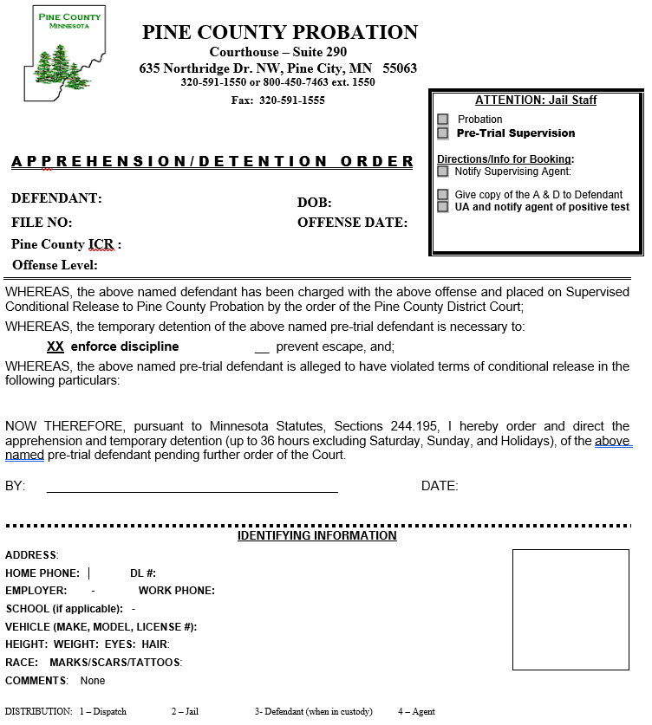
A & D

Slide 21
Actuarial Risk Assessments
MNPAT
LS/CMI
YLS
AUDIT
DVI
STATIC-99
MNSTARR

Slide 22
Probation Reports
Bail Evaluations
Pre-Sentence Investigation (adults)
Pre-Dispositional Reports (juveniles)
Sentencing Guidelines Worksheets
Probation Violation Sanctions Agreements
Probation Violation Reports

Slide 23
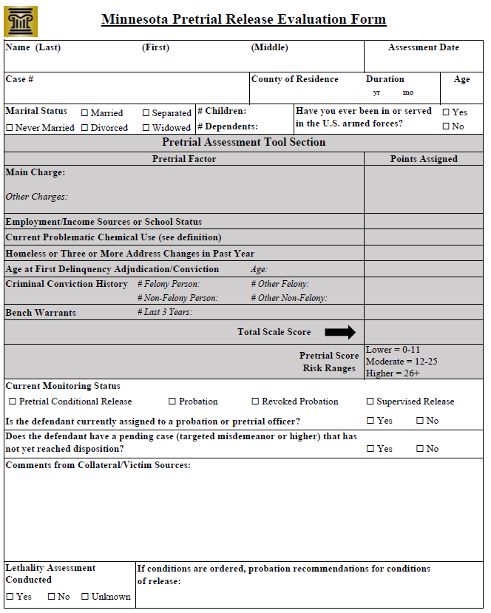
Minnesota Pretrial Assessment Tool:
MNPAT

Slide 24
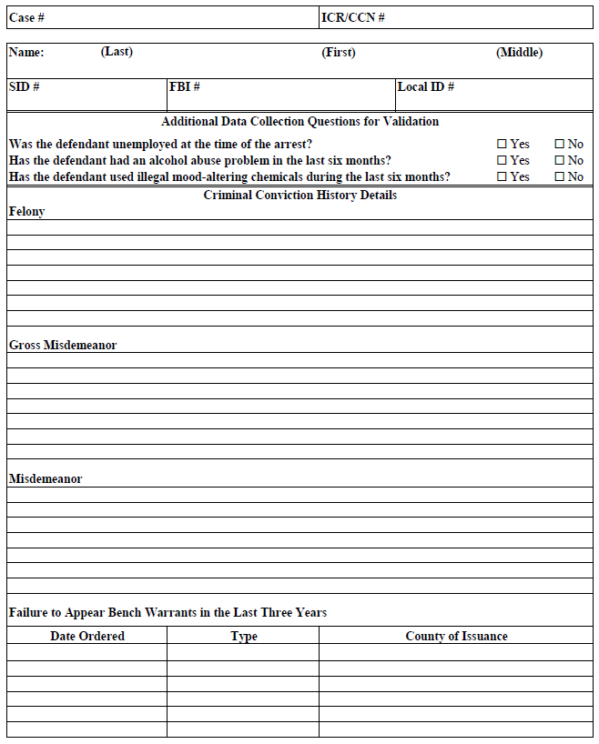
Minnesota Pretrial Assessment Tool:
MNPAT

Slide 25
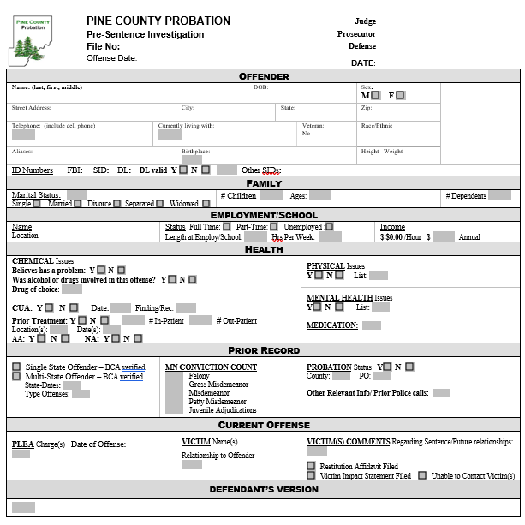
Pre-Sentence Investigation

Slide 26
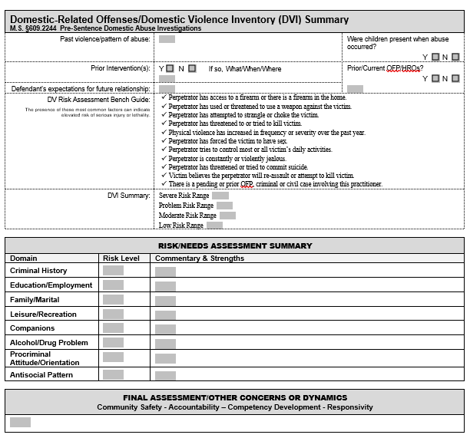
Pre-Sentence Investigation

Slide 27
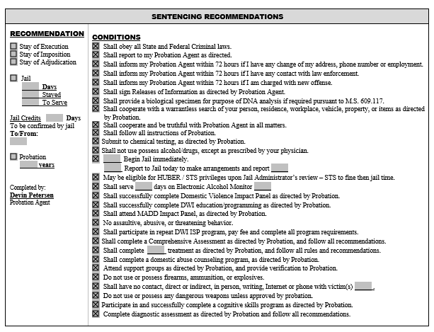
Pre-Sentence Investigation

Slide 28
Behavior Change
What community supervision is all about!

Slide 29
Actions
Feelings
Thoughts
Minnesota Association of County Probation Officers
2023

Slide 30
Behaviors
Thoughts/Feelings
Attitudes/Values/Beliefs
External
Internal
Minnesota Association of County Probation Officers
2023

Slide 31
The RNR Framework
Risk Principle
  Correctional interventions should target (specific) risk factors most likely to influence criminal behavior
Need Principle
  Correctional interventions are most effective when based on research-supported models and tailored to individual personality characteristics
Responsivity Principle
  Correctional interventions should be matched with risk level, with more intensive interventions reserved for medium-to-high risk clients

Slide 32
Agent Toolbox
Individualized Tools
Thinking Reports
Group Programs
Decision Points
Behavior Chains
Problem Solving
Reflection Diaries
Cost Benefit Analysis
Pro V. Con List
Carey Guides
Thinking for a Change
Moving On

Slide 33
Examples of Evidence-Based Interventions
Cost-Benefit Analysis
  2:01:48 – 2:47:10
Antisocial Thinking Carey Guide
  1:52:10 – 2:14:55
Moving from Chaos to Focus on Driver
Carey Guide – Interpersonal Skills: Expanding Social Network
  1:03:00 – 1:45:12

Slide 34
Why
Join MACPO?

Slide 35
MACPO – Membership Benefits
Supports the preservation and expansion of community supervision agencies in Minnesota
$15 per year ($10 if pay via check) for student memberships
Access to MACPO trainings at reduced cost
$750 scholarship offered to students (must be MACPO members) majoring in Criminal Justice or a related field
Email Blasts/MACPOST
NETWORKING with Probation Agents – CONNECTIONS!

Slide 36
MAPCO WEBSITE
Website – Click Here
Scholarship
Jobs
Internship Information
Merchandise

Slide 37
Advice for Breaking into the Field – KNOW THESE THINGS
Cognitive Behavioral Programs
The RNR Framework
The Dosage Principle
Actuarial Risk Assessments
Dynamic v. Static Risk Factors
Criminogenic Needs
General v. Specific Responsivity
Coach v. Referee Mentality
Correctional Quackery
The Central 8
The Big 4
The Little 4
Principles of Effective Intervention
Core Correctional Practices
Evidence Based Practices (EBP)

Slide 38
Advice for Breaking into the Field
Probation Agents in Minnesota must:
  Complete probation internship and their 4-year degree
Positions that will prepare you for Probation Work:
  Probation Internship
  Anything related to Mental Health and/or Case Management
  Treatment Centers, Detoxification Facilities, and/or Homeless Shelters
  Jail/Court Experience
    Guardian ad Litem
    Victim Advocate
    Correctional Officers
    Social Work

Slide 39
Questions? emily.ostlund@goodhuecountymn.gov devin.petersen@co.pine.mn.us

